Slide 1




Slide 2
Content
1) Problem Statement
2) Proposed Solution
3) Product Description
4) Market Size
5) Business Model
6) Technology Stack
7) How We Would be Using Here Technologies Products
8) Marketing Strategy
9) Competitors and USPs

Slide 3




Problem Statement
End to end trip planner → Provide Application users with functionality to create a multiple-days and multiple locations trip with best of routes and POIs suggestions

Slide 4
Proposed Solution
To make an application just like our normal google map which would be easy to operate, and we can manage/add checkpoints on the way between and manage our bookings and other destinations and stops within the same application.

Slide 5
Product Description
It would be used to plan multiple days trips with accurate markings and to do list, it would be working on live situation basis, i.e., would be telling us best routes, nearby destinations, stops, restaurants and many other things as well.

Slide 6
Market Size
With the ever-growing digitalization market is not only limited to _ outdoors but an essential part of our screens.
Digital Marketing & advertisements are essential parts of our lives. Studies show that the surge in digital advertising is ever increasing.

Slide 7
In our application, on certain pages some part of the screen will be available for advertisement purposes .
Where digital ads of various companies, outlets & services will be running
Also we can incorporate CPA (Cost per action) marketing i.e whenever a user clicks on a certain link we can make revenue through this action

Slide 8
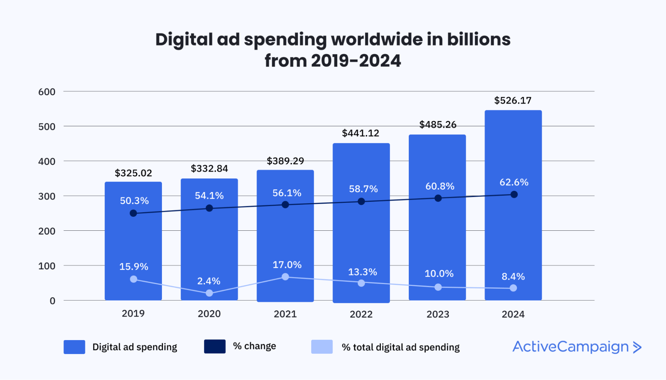

Slide 9
Business Model
So, our proposed business model would be like a user is planning for a trip and uses our application, so they would be requiring some bookings to be done like hotel booking, flights and many other things, so from that end is one of our USP
Other thing would be like if someone is passing by some destination or place then we could promote a particular place or thing by just asking for our service.

Slide 10
Technology Stack
Here Route Planner Solution
Here Studio
API Services
Here SDK
Android Studio
Java/Python

Slide 11
How We Would Be Using Here Technologies Products
As we are now familiar with Here, we got to know that Here is an IT Company which provides products based on the needs of the customers. The company mainly focuses on mapping products which are used by many big companies.
So, we would be using Here live traffic API and map API to have a mapping feature, we would be developing our product using the Here SDK.

Slide 12
Marketing Strategy
We the youngsters, the current generation is more often to use new technologies or new things and we require to use maps services to go to even one single destination, so the application would be totally based on us.
So, the marketing of the application can be done more easily on social networking sites, especially on Instagram where we can find Tours and Travels pages and just have our product displayed on them and similarly, we can find more communities like this and pages on Facebook of similar interest.

Slide 13
Competitors and USPs
The main competitors are simply some of the trip planner applications, like, MakeMyTrip, Goibibo, Trivago, etc., but our main USP(Unique Selling Point) is that we would be adding a map feature so that a traveler can even go to the hotel or the exact place they want to go without switching any other application on their devices.

Slide 14





Thank You Team AtLine

